Slide 1
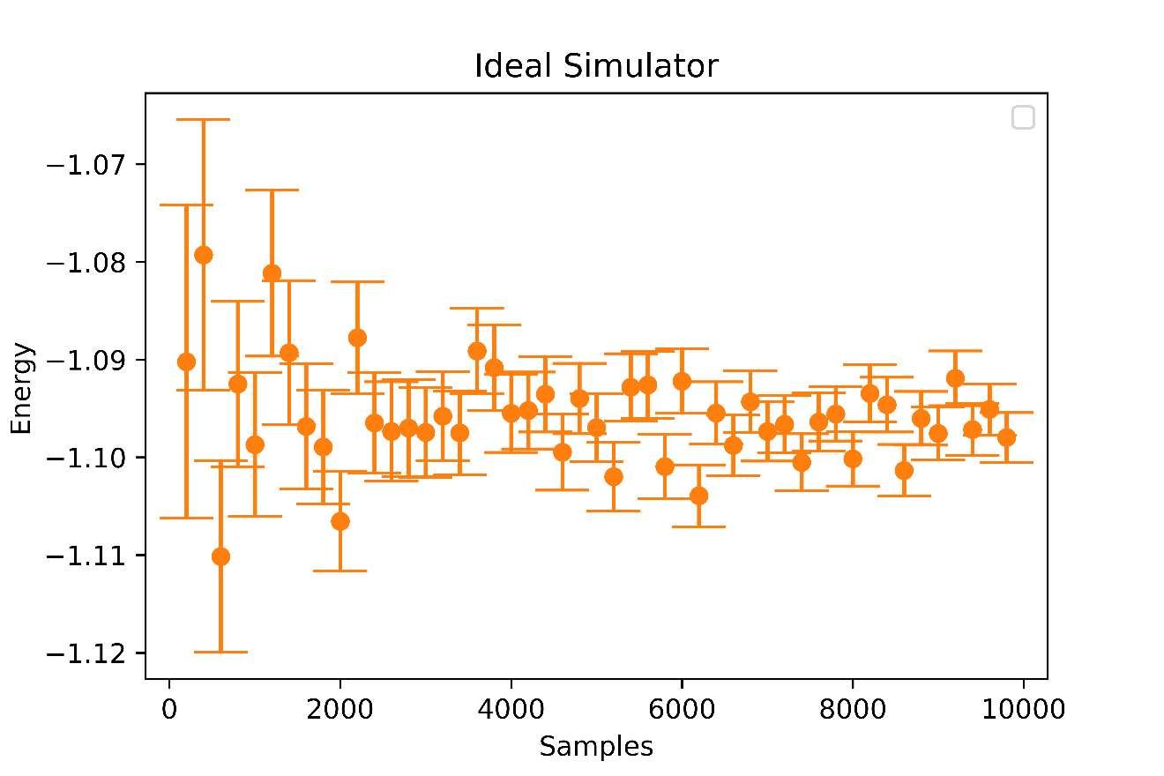
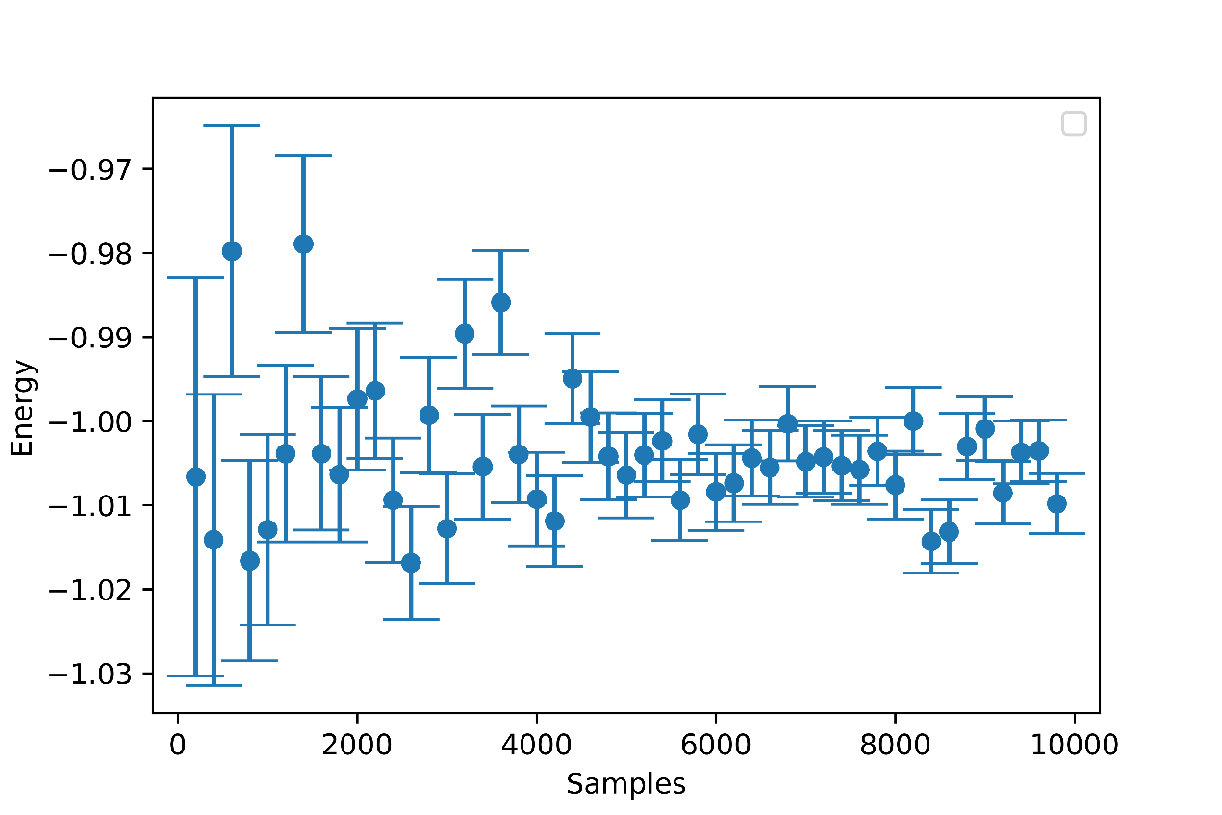
Expectation Value as a function of sample Size
Computing the optimized energy (energy as a function of optimal parameters) of a VQE circuit for Hydrogen molecule
Each point on the graph corresponds to 200n samples where 0<=n<=50
Noise Model

